Slide 1
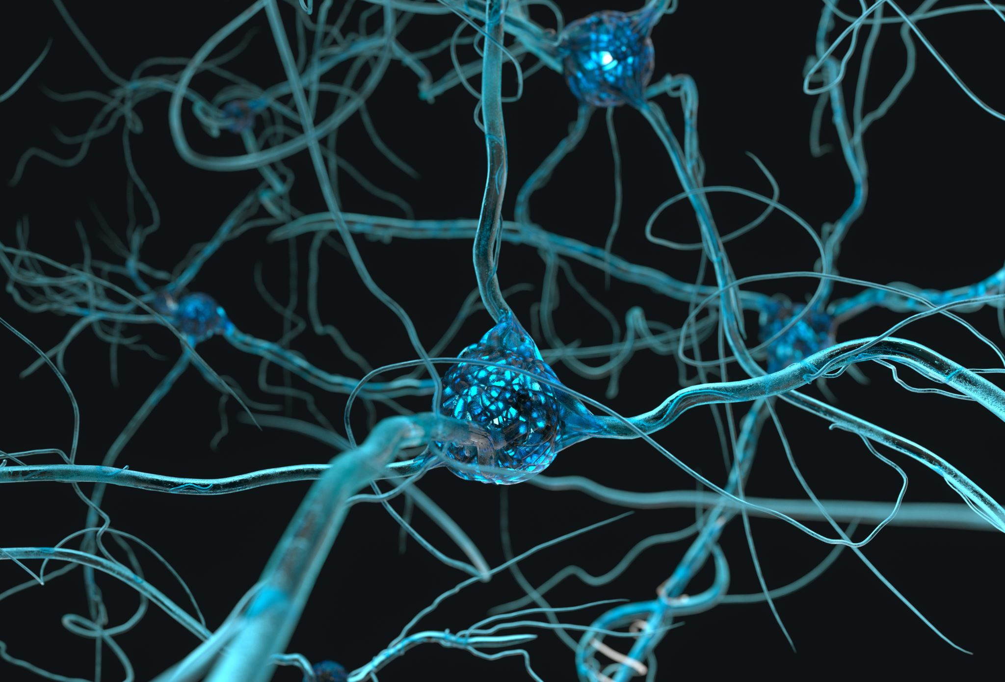
Artificial Neural Network & Backpropagation

Slide 2
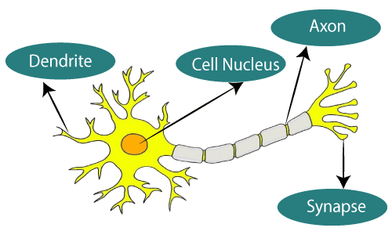
Neuron
Biological Neuron

Slide 3
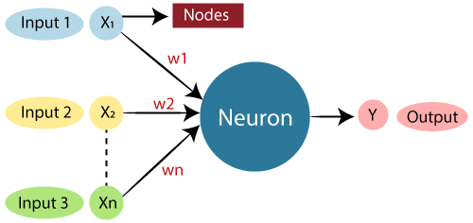
Neuron
Artificial Neuron

Slide 4
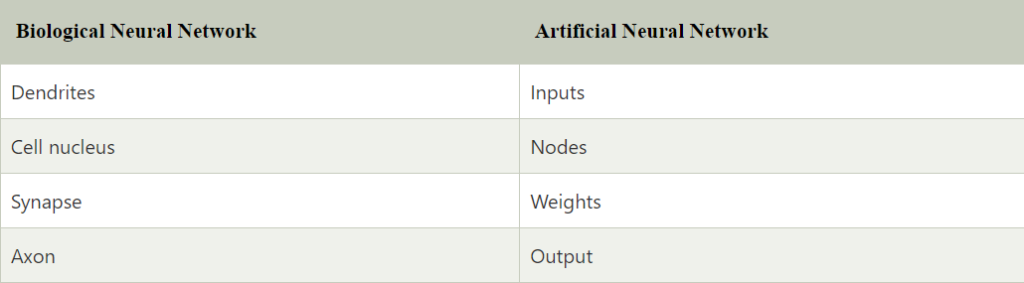
Biological VS Artificial Neuron

Slide 5
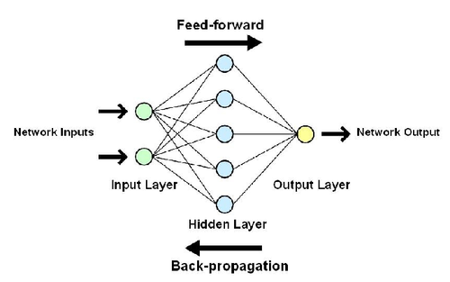

Artificial Neural Network
Input Layer:
Hidden Layer: Calculations to find hidden features
Output Layer:

Slide 6
Convolutional Neural Network (CNN)
Recurrent Neural Network (RNN)
Types of ANN
Gated Recurrent Unit (GRU)
Long Short-term Memory (LSTM)

Slide 7
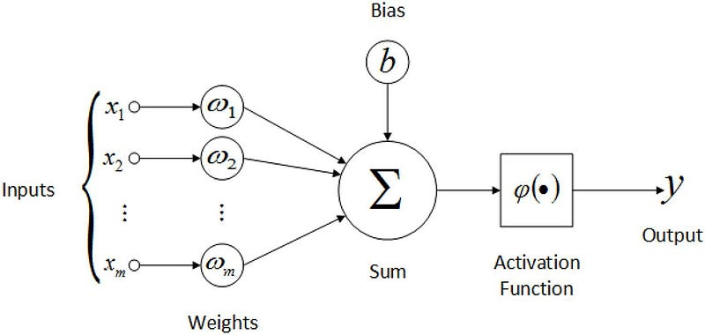
Feed Forward Neural Network
Inputs are fed into the input layer.
Each input is multiplied by corresponding weights.
Weighted sums are passed through an activation function.
Outputs of activation functions are passed to the next layer.
Process repeats until the output layer produces the final output.

Slide 8
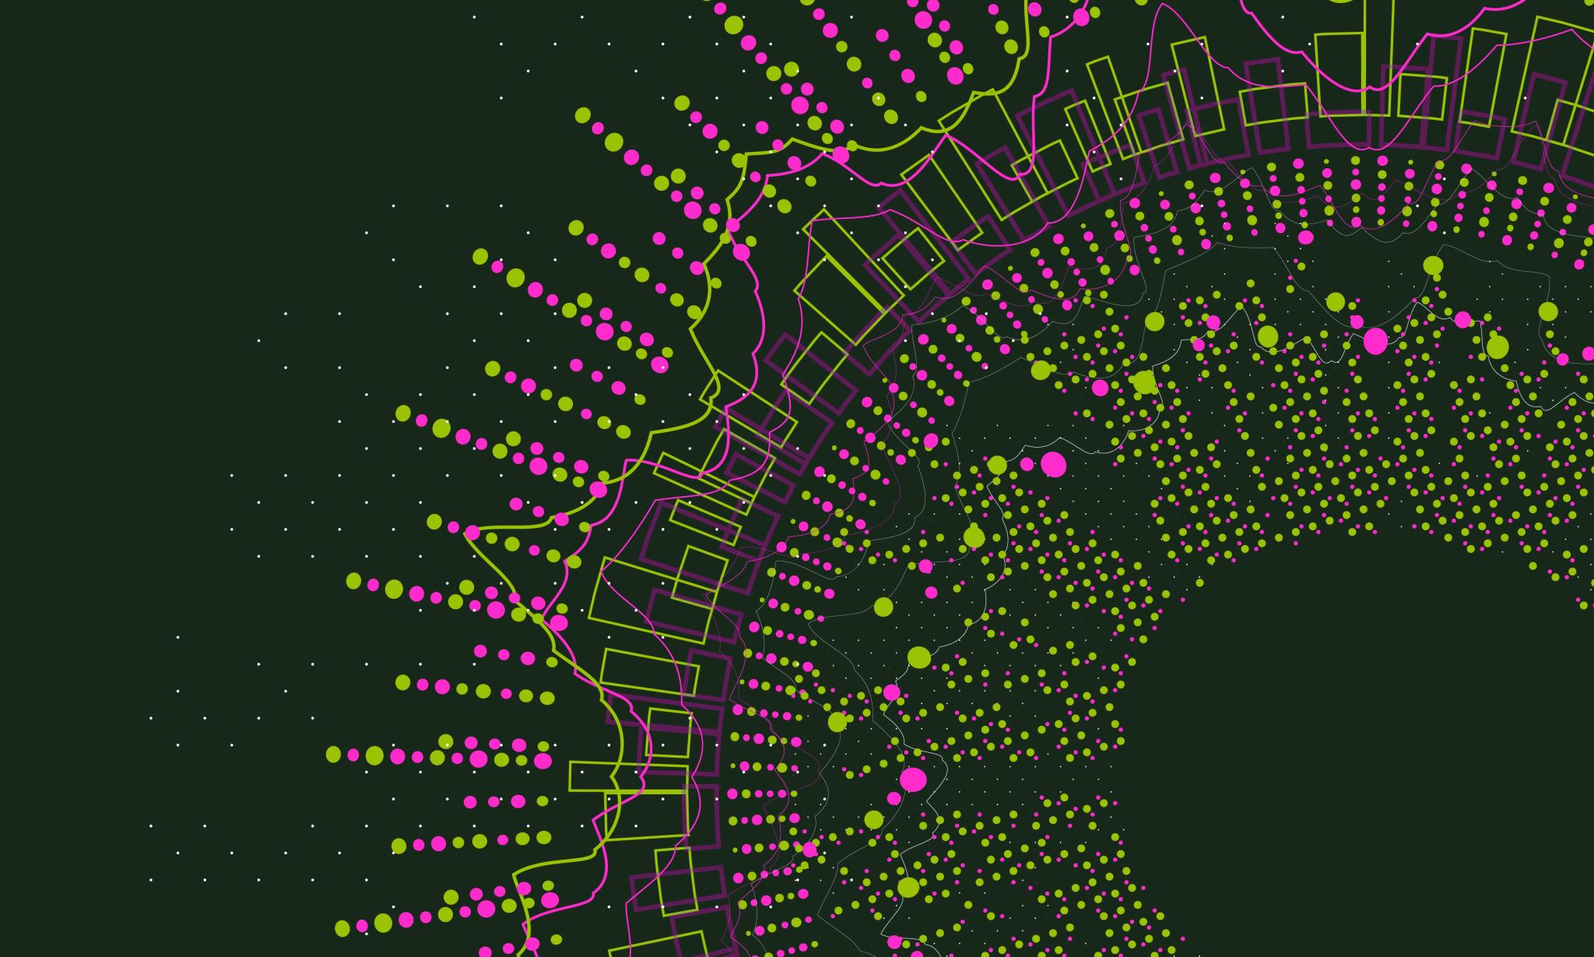
Activation Function

Slide 9
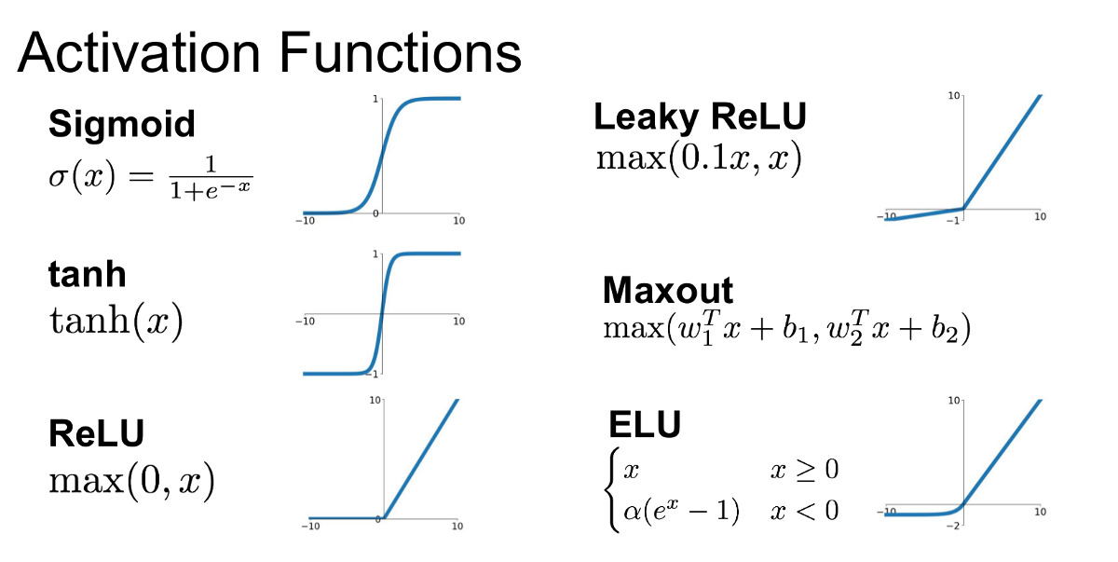
Activation Function
Non-Linearity: Essential for learning complex patterns and decision boundaries.
Gradient Flow: Affects how gradients backpropagate through the network
Output Range: Determines the scale of the output, which can impact training stability and convergence speed.
Computational Efficiency: Impacts the training time and resource usage of the network.

Slide 10

Types of Activation Function
1. Linear Activation Function:
does not introduce non-linearity into the model
2. Non-Linear Activation Function:
Sigmoid: S shapes curve that maps input values into 0 & 1
- Binary classification
Tanh: A differentiable, sigmoid-like function that maps the input to a value between -1 and 1.
- Used in RNN
ReLU: Rectified Linear Unit
- Non-Differentiable
- Maps values in between 0 & all positive values
Softmax: Differentiable function that maps the input to a probability distribution over all classes.
- Used in multiclass classification.

Slide 11
Backpropagation
Train neural networks by minimizing the error between predicted and actual outputs.
Error Calculation
Use to reduce the Loss

Slide 12
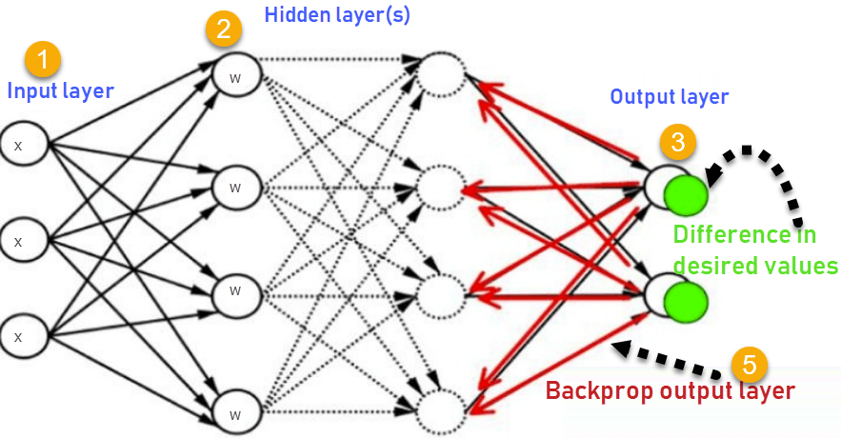
Working of Backpropagation
Inputs X, arrive through the preconnected path
Input is modeled using real weights W. The weights are usually randomly selected.
Calculate the output for every neuron from the input layer, to the hidden layers, to the output layer.
Calculate the error in the outputs
Error = Actual Output – Desired Output

